Slide 1
RAINFALL PREDICTION USING ARIMA AND LINEAR REGRESSION MODEL
BATCH:- A12
DOMAIN:- Machine Learning
NAME:- Supriya.S (211418104275)
Surya.P (211418104278)
Swetha. N (211418104284)
GUIDE NAME:- Dr.K.Sangeetha

Slide 2
ABSTRACT
Rainfall forecasting is very important because heavy and irregular rainfall can have many impacts like destruction of crops and farms, damage of property so a better forecasting model is essential for an early warning that can minimize risks to life and property and also managing the agricultural farms in better way.
The proposed scheme provides annual rainfall prediction and four seasonal rainfall predictions such as summer, autumn, rainy, and winter.
The ARIMA trained on 1400 epoch for revealing very good results. Linear regression is acted as the best optimizer.
The ARIMA model revealed better accuracy in all of the seasonal and annual rainfall.
We use the real data from Indian government website https://data.gov.in/ and compare the model quality based on several criteria in ARIMA.

Slide 3
LITERATURE SURVEY
TITLE OF THE PAPER | AUTHOR NAME | JOURNAL NAME | METHODOLOGY | PROS | CONS
Time series analysis model to forecast rainfall for Allahabad region. (2017) | Anosh Graham and Ekta Pathak Mishra. | Journal of Pharmacognosy and Phytochemistry. | Seasonal ARIMA. | The seasonal ARIMA model provide consistent and satisfactory predictions for rainfall parameters on monthly scale. | Accuracy of these predictions can be increased in future by using these predicted values for missing values.
DOI: https://www.phytojournal.com/archives/2017/vol6issue5/PartU/6-5-80-125.pdf

Slide 4
LITERATURE SURVEY
TITLE OF THE PAPER | AUTHOR NAME | JOURNAL NAME | METHODOLOGY | PROS | CONS
Short-term Rainfall Forecasting Using Multi-layer Perceptron. (2018) | Pengcheng Zhang, Yangyang Jia, Jerry Gao, Wei Song, Hareton Leung. | IEEE | Dynamic Regional Combined short-term rainfall Forecasting approach (DRCF) using Multi-layer Perceptron (MLP). | To solve the clutter interference which is caused by the extension of the perception range, DRCF is enhanced with several dynamic strategies. | The forecasting interval of DRCF is limited on 3 hours and the greedy algorithm can only decide the optimal structure of local MLP, but cannot get the global optimal structure.
DOI: https://ieeexplore.ieee.org/document/8468083

Slide 5
LITERATURE SURVEY
TITLE OF THE PAPER | AUTHOR NAME | JOURNAL NAME | METHODOLOGY | PROS | CONS
Weather Forecasting Using Machine Learning Algorithm. (2019) | Nitin Singh, Saurabh Chaturvedi, Shamim Akhter. | IEEE | Raspberry Pi, Random Forest. | In this paper, a low-cost and portable solution for weather prediction is devised. | The size of the test set is 1835, out of which the number 1491 represents the count of correct predictions that rain will not happen and 122 is the number of correct predictions that rain will happen.
DOI: https://ieeexplore.ieee.org/document/8938211

Slide 6
LITERATURE SURVEY
TITLE OF THE PAPER | AUTHOR NAME | JOURNAL NAME | METHODOLOGY | PROS | CONS
Rainfall Prediction Using Machine Learning. (2019) | Arnav Garg, Himanshu Pandey. | International Journal of Innovative Science and Research Technology. | SVR, SVM and KNN. | Though all the algorithms i.e. SVM, SVR and KNN are equally useful, for rainfall prediction SVM and SVR are more accurate than KNN. | Even though SVR provides near perfect if we consider all the anomalies and biases found of nature.
DOI: https://ijisrt.com/wp-content/uploads/2019/05/IJISRT19MY198.pdf

Slide 7
LITERATURE SURVEY
TITLE OF THE PAPER | AUTHOR NAME | JOURNAL NAME | METHODOLOGY | PROS | CONS
Rainfall Prediction using Machine Learning & Deep Learning Techniques. (2020) | Cmak Zeela Basha, Nagulla Bhavana, Ponduru Bhavya, Sowmya V. | IEEE | ARIMA Model, Artificial Neural Network, Logistic Regression, Support Vector Machine and Self Organizing Map. | Artificial Neural Network makes a superior solution to all approaches available. | It will be difficult to predict for small changes in climate.
DOI: https://ieeexplore.ieee.org/document/9155896

Slide 8
LITERATURE SURVEY
TITLE OF THE PAPER | AUTHOR NAME | JOURNAL NAME | METHODOLOGY | PROS | CONS
Prediction Of Rainfall Using Machine Learning Techniques. (2020) | Moulana Mohammed, Roshitha Kolapalli, Niharika Golla, Siva Sai Maturi. | International Journal Of Scientific & Technology Research. | SVR | This project is to offer non-experts easy access to the techniques, approaches utilized in the sector of precipitation prediction and provide a comparative study among the various machine learning techniques. | The main challenge is to build a model for long term rainfall prediction.
DOI: http://www.ijstr.org/final-print/jan2020/Prediction-Of-Rainfall-Using-Machine-Learning-Techniques.pdf

Slide 9
LITERATURE SURVEY
TITLE OF THE PAPER | AUTHOR NAME | JOURNAL NAME | METHODOLOGY | PROS | CONS
Rain Prediction Using Rule-Based Machine Learning Approach. (2020) | Uchamad Taufiq Anwar, Saptono Nugrohadi, Vita Tantriyati, Vikky Aprelia Windarni. | Advance Sustainable Science, Engineering and Technology. | J48 method. | The experiment using the J48 method resulted in up to 77.8% accuracy in the training model and gave accurate prediction results of 86% when tested against actual weather data in 2020. | A small change in the data can result in a major change in the structure of the decision tree, which can convey a different result from what users will get in a normal event.
DOI: http://journal.upgris.ac.id/index.php/asset/article/view/6019

Slide 10
LITERATURE SURVEY
TITLE OF THE PAPER | AUTHOR NAME | JOURNAL NAME | METHODOLOGY | PROS | CONS
Rainfall forecasting model using machine learning methods: Case study Terengganu, Malaysia. (2020) | Wanie M. Ridwan, Michelle Sapitang, Awatif Aziz,Khairul Faizal Kushiar, Ali Najah Ahmed, Ahmed El-Shafie. | Science Direct. | Bayesian Linear Regression (BLR), Boosted Decision Tree Regression ,Decision Forest Regression (DFR) and Neural Network Regression. | Forecasting Rainfall Using Autocorrelation Function shows high accuracy. | Accurate rainfall prediction might be achieved by proposing hybrid machine learning algorithms and with the inclusion of different climate change scenarios.
DOI: https://www.sciencedirect.com/science/article/pii/S2090447920302069

Slide 11
LITERATURE SURVEY
TITLE OF THE PAPER | AUTHOR NAME | JOURNAL NAME | METHODOLOGY | PROS | CONS
Prediction of Short-Time Rainfall Based on Deep Learning. (2021) | Dechao Sun, Jiali Wu, Hong Huang, Renfang Wang , Feng Liang, and Hong Xinhua. | Hindawi. | GRU. | The experimental results show that the algorithm can effectively extract the temporal and spatial features of radar echo maps, reduce the error between the predicted value and the real value of rainfall, and improve the accuracy of short-term rainfall prediction. | The features like meteorological features, temperature, wind field are not included.
DOI: https://www.hindawi.com/journals/mpe/2021/6664413/

Slide 12
LITERATURE SURVEY
TITLE OF THE PAPER | AUTHOR NAME | JOURNAL NAME | METHODOLOGY | PROS | CONS
Rainfall Prediction Using Machine Learning Algorithms for the Various Ecological Zones of Ghana. (2021) | Nana Kofi Ahoi Appiah-Badu, Yaw Marfo Missah, Leonard K. Amekudzi, Najim Ussiph, Twum Frimpong, And Emmanuel Ahene. | IEEE | Decision Tree (DT), Random Forest (RF), Multilayer Perceptron (MLP), Extreme Gradient Boosting (XGB) and K-Nearest Neighbour (KNN) | Decision Tree is consistently portrayed as the fastest, whereas MLP used the most run time. | K-Nearest Neighbour performed worst in all zones on all training and testing ratios.
DOI: https://ieeexplore.ieee.org/abstract/document/9664520

Slide 13
PROBLEM DEFINITION
Rainfall forms the primary input to the river basin, affecting the water capacity a stream, particularly during the torrential rainfall event.
Moreover, one of the major focuses of climate change study is to understand whether there is an extreme change in the occurrence and frequency of heavy rainfall events.
The accuracy level of the ML models used in predicting rainfall based on historical data has been one of the most critical concerns in hydrological studies.
Hence, there are needs to develop ML algorithms capable in predicting rainfall with acceptable level of precision and in reducing the error in the dataset of the projected rainfall from climate change model with the expected observable rainfall.

Slide 14
FEASIBILITY ANALYSIS
The feasibility of the project is analyzed in this phase and business proposal is put forth with a very general plan for the project and some cost estimates.
During system analysis the feasibility study of the proposed system is to be carried out. This is to ensure that the proposed system is not a burden to the company.
For feasibility analysis, some understanding of the major requirements for the system is essential.

Slide 15
TECHNICAL FEASIBILITY
This project deals with rainfall prediction. Time series analysis model using in the project is helpful in predicting future aspects of data.
Machine Learning algorithms and techniques using in the project will be helpful with good accuracy score and in rainfall also it gives pretty good prediction.
The system is developed using Python language and Flask framework which provides libraries, modules and tools to build web-application.

Slide 16
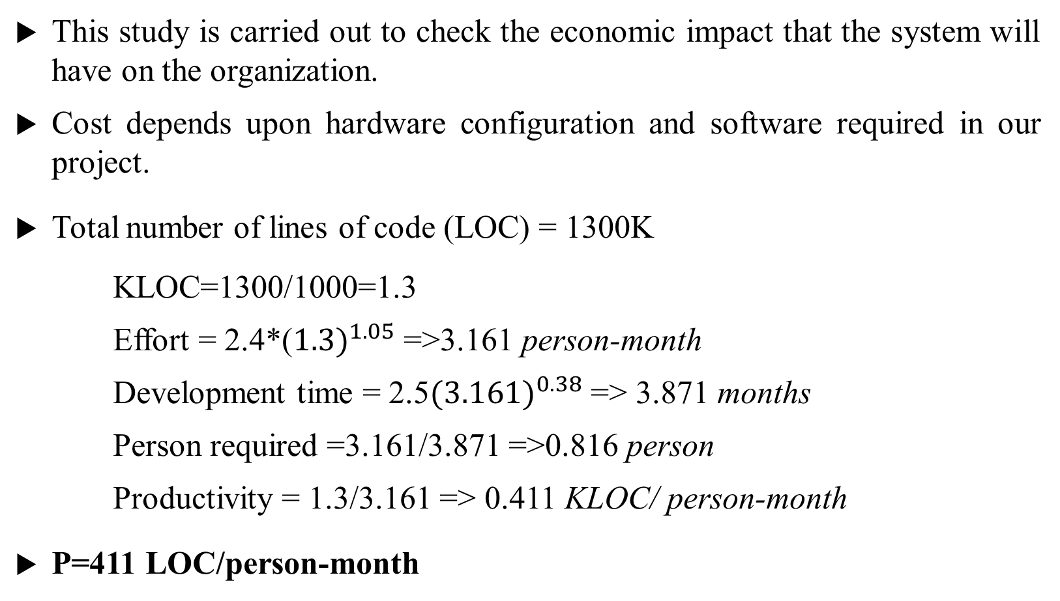
ECONOMICAL FEASIBILITY
This study is carried out to check the economic impact that the system will have on the organization.
Cost depends upon hardware configuration and software required in our project.
Total number of lines of code (LOC) = 1300K
KLOC=1300/1000=1.3
Effort = 2.4*(${1.3)}^{1.05}$ =>3.161 person-month
Development time = 2.5${(3.161)}^{0.38}$ => 3.871 months
Person required =3.161/3.871 =>0.816 person
Productivity = 1.3/3.161 => 0.411 KLOC/ person-month
P=411 LOC/person-month

Slide 17
SOCIAL FEASIBILITY
Rainfall is one of the difficult and uncertain tasks that have a significant impact on human society.
Timely and accurate forecasting can productively help to reduce human and financial loss.
The project is social feasible.

Slide 18
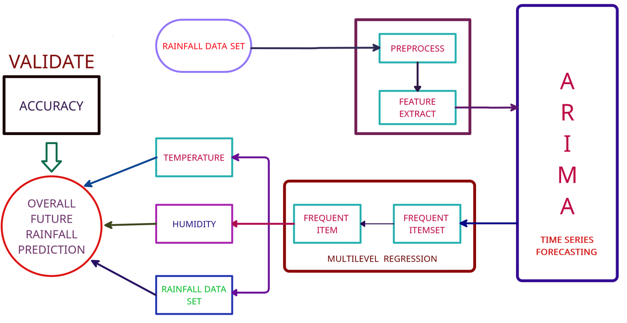
SYSTEM ARCHITECTURE

Slide 19
REFERENCES
U.Ashwini, K.Kalaivani* , K.Ulagapriya and A.Saritha, year 2021, “Time Series Analysis based Tamilnadu Monsoon Rainfall Prediction using Seasonal ARIMA” ,IEEE, Chennai, India.
DOI:https://ieeexplore.ieee.org/document/9358615
Anosh Graham , Ekta Pathak Mishra, year 2017, “Time series analysis model to forecast rainfall for Allahabad region”, Journal of Pharmacognosy and Phytochemistry, Uttar Pradesh, India.
DOI:https://www.phytojournal.com/archives/2017/vol6issue5/PartU/6-5-80-125.pdf
Pengcheng Zhang, Yangyang Jia, Jerry Gao, Wei Song, Hareton Leung, year 2018, “Short-term Rainfall Forecasting Using Multi-layer Perceptron”, IEEE, China.
DOI: https://ieeexplore.ieee.org/document/8468083

Slide 20
REFERENCES
Nitin Singh, Saurabh Chaturvedi, Shamim Akhter, year 2019, “Weather Forecasting Using Machine Learning Algorithm”, IEEE, noida, India.
DOI:https://ieeexplore.ieee.org/document/8938211
Arnav Garg, Himanshu Pandey, year 2019, “Rainfall Prediction Using Machine Learning”, International Journal of Innovative Science and Research Technology, Kanchipuram Tamil Nadu, Volume 4, Issue 5.
DOI:https://ijisrt.com/wp-content/uploads/2019/05/IJISRT19MY198.pdf
CMAK Zeelan Basha, Nagulla Bhavana, Ponduru Bhavya, Sowmya V, year 2020, “Rainfall Prediction Using Machine Learning & Deep Learning Techniques “, International Conference on Electronics and Sustainable Communication Systems, Guntur, India.
DOI: https://ieeexplore.ieee.org/document/9155896

Slide 21
REFERENCES
Moulana Mohammed, Roshitha Kolapalli, Niharika Golla, Siva Sai Maturi, Year 2020, "Prediction Of Rainfall Using Machine Learning Techniques", international journal of scientific & technology research, volume 9, issue 01.
DOI:http://www.ijstr.org/final-print/jan2020/Prediction-Of-Rainfall-Using-Machine-Learning-Techniques.pdf
Uchamad Taufiq Anwar, Saptono Nugrohadi, Vita Tantriyati, Vikky Aprelia Windarni, year 2020, “Rain Prediction Using Rule-Based Machine Learning Approach”, Advance Sustainable Science, Engineering and Technology, Indonesia.
DOI: http://journal.upgris.ac.id/index.php/asset/article/view/6019
Wanie M. Ridwan, Michelle Sapitang, Awatif Aziz, Khairul Faizal Kushiar, Ali Najah Ahmed, Ahmed El-Shafie, year 2020,“Rainfall forecasting model using machine learning methods:Casestudy Terengganu,Malaysia”,AinShams Engineering Journal, Terengganu, Malaysia.
DOI:https://www.sciencedirect.com/science/article/pii/S2090447920302069

Slide 22
REFERENCES
Dechao Sun, Jiali Wu, Hong Huang, Renfang Wang , Feng Liang, and Hong Xinhua, year 2021, “Prediction of Short-Time Rainfall Based on Deep Learning”, Hindawi, Ningbo, China, Volume 2021, 8 pages.
DOI: https://www.hindawi.com/journals/mpe/2021/6664413/
Nana kofi ahoi appiah-badu, yaw marfo missah, leonard k. amekudzi, najim ussiph, twum frimpong, and emmanuel ahene, year 2021, “Rainfall Prediction Using Machine Learning Algorithms for the Various Ecological Zones of Ghana”, IEEE, volume 10.
DOI: https://ieeexplore.ieee.org/abstract/document/9664520

